Slide 1

Mindreading & Joint Action
Mindreading & Joint Action
2. What are mental states?
butterfillS@ceu.hu
butterfillS@ceu.hu
Notes:
Last week I suggested that we don’t adequately understand what mindreading is.
Of course we can *define* mindreading.
Mindreading is the process of identifying mental states and actions as the mental states and actions of a particular subject on the basis, ultimately, of bodily movements and their absence, somewhat as reading is the process of identifying propositions on the basis of inscriptions (Apperly 2010, p. 4).
Not adequately understanding mindreading means that there are questions we can’t answer, and puzzles we can’t resolve, and that a deeper understanding of what mindreading is might be needed to answer those questions and resolve those puzzles.
Anyway, this week I start from the assumption that we agree on wanting a deeper understanding of what mindreading is.
As mindreading is defined in terms of mental states, the natural question to ask is,
What are mental states?
Need to be careful here. Since our interest is in mindreading, we don’t necessarily want the truth about mental states. We merely want a theoretically coherent conception of them.

Slide 2
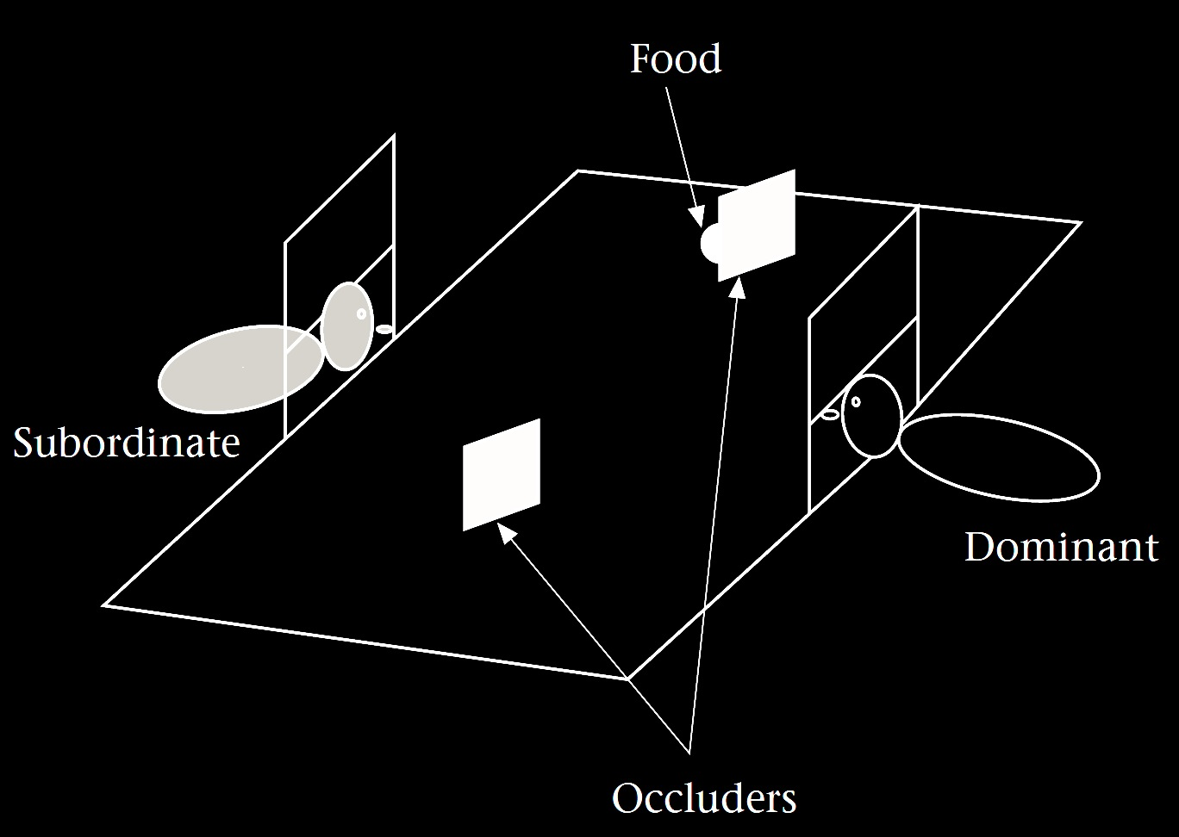
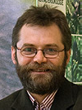
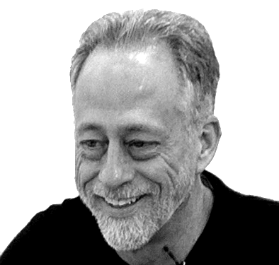
‘chimpanzees understand … intentions … perception and knowledge … Moreover, they understand how these psychological states work together to produce intentional action’
(Call & Tomasello 2008:191)
Notes:
To illustrate the need for this, consider Call & Tomasello’s claim.
What are Call & Tomasello saying the chimps understand?

Slide 3
‘chimpanzees understand … intentions … perception and knowledge … Moreover, they understand how these psychological states work together to produce intentional action’
(Call & Tomasello 2008:191)
Notes:
First note that this is a claim about understanding. They are not saying that chimps discriminate situations in which another knows from situations in which she is ignorant.
They are saying that chimps understand something about the knowledge states that constitute the difference between these situations.

Slide 4
‘chimpanzees understand … intentions … perception and knowledge … Moreover, they understand how these psychological states work together to produce intentional action’
(Call & Tomasello 2008:191)
Notes:
But what are they saying when they say that chimps understand knowledge? What does this amount to?

Slide 5
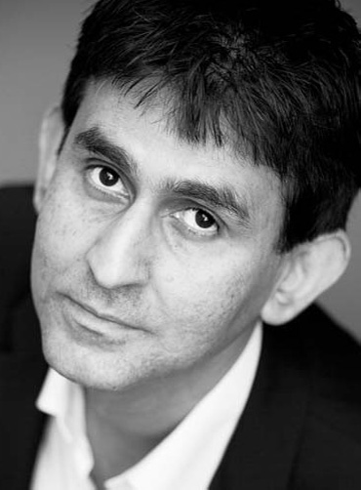
‘chimpanzees understand … intentions … perception and knowledge … Moreover, they understand how these psychological states work together to produce intentional action’
(Call & Tomasello 2008:191)
‘our fundamental conception of what it is to know that P is itself an explanatory conception […] we think of S’s knowledge that P as something that can properly be explained by reference to what S has perceived or remembered or proved or ...’
(Cassam 2007: 356)
Notes:
Take Quassim Cassam ... are they saying that Chimpanzees have this conception of knowledge? Probably not. After all, they may not want to be committed to saying that chimpanzees think of knowledge states as standing in need of explanation; they may not want to claim that chimpanzees sometimes think to themselves, I wonder how she knew about that?
But then what conception of knowledge do Call & Tomasello think chimpanzees have?
I think that this quote is fine if it is intended just to give us a very rough idea about what chimpanzees think.
But it would be a mistake to think that it gives us deep insight into what chimpanzees represent that enables them to track knowledge states.
The problem is that, pre-theoretically, we don’t have a clear enough sense of what ‘knowledge’ is to know what might be involved in understanding knowledge.
My aim in asking what mental states are is this.
If we can characterise---or mischaracterise---knowledge, belief and others, then we might be in a position to be more explicit about what chimpanzees and humans and others understand

Slide 6
Ayesha
Steve
Henry
...
believes
desires
intends
...
Ayesha will cycle up Hármashatár hill
s/he will cycle up Hármashatár hill
Henry will win the lottery
...
that
Notes:
subject --- attitude --- content

Slide 7
Ayesha
Steve
Henry
...
believes
desires
intends
...
Ayesha will cycle up Hármashatár hill
s/he will cycle up Hármashatár hill
Henry will win the lottery
...
that
Subject
Attitude
Content
Notes:
subject --- attitude --- content

Slide 8
Ayesha
Steve
Henry
...
believes
desires
intends
...
Ayesha will cycle up Hármashatár hill
s/he will cycle up Hármashatár hill
Henry will win the lottery
...
that
Subject
Attitude
Content
Notes:
subject --- attitude --- content

Slide 9
Ayesha
Steve
Henry
...
believes
desires
intends
...
Ayesha will cycle up Hármashatár hill
s/he will cycle up Hármashatár hill
Henry will win the lottery
...
that
Subject
Attitude
Content
Notes:
subject --- attitude --- content

Slide 10
Ayesha
Steve
Henry
...
believes
desires
intends
...
Ayesha will cycle up Hármashatár hill
s/he will cycle up Hármashatár hill
Henry will win the lottery
...
that
Subject
Attitude
Content
Notes:
The content is what distinguishes one belief from all others, or one desire from all others.
The content is also what determines whether a belief is true or false, and whether a desire is satisfied or unsatisfied.
There are two main tasks in constructing a theory of mental states.
The first task is to characterise the different attitudes.
This typically involves specifying their distinctive functional and normative roles.
The second task is to find a scheme for specifying the contents of mental states.
Let’s start with the second task and come back to the first. [***OR SHOULD I POSTPONE THE SECOND TASK UNTIL THE LECTURE ON MEASUREMENT?]

Slide 11
Ayesha
Steve
Henry
...
believes
desires
intends
...
Ayesha will cycle up Hármashatár hill
s/he will cycle up Hármashatár hill
Henry will win the lottery
...
that
Subject
Attitude
Content
Notes:
The second task is to find a scheme for specifying the contents of mental states.
Usually this is done with propositions.
But what are propositions?
Propositions are abstract objects like numbers.
They have more mystique than numbers, but, like numbers, they are abstract objects that can be constructed using sets plus a few other basic ingredients such as objects, properties and possible worlds.

Slide 12
‘Propositions ... are the sharable objects of the attitudes and the primary bearers of truth and falsity’ (McGrath 2012)
Ayesha
Steve
Henry
...
believes
desires
intends
...
Ayesha will cycle up Hármashatár hill
s/he will cycle up Hármashatár hill
Henry will win the lottery
...
that
Subject
Attitude
Content
Notes:
There are actually quite a few different views about what propositions are.
For example, McGrath says that ‘Propositions ... are the sharable objects of the attitudes and the primary bearers of truth and falsity’ \citep{McGrath:2012pro}.
Others introduce propositions by appeal to sentences, or utterances of sentences. Here the idea is that a proposition is what the utterance of a sentence expresses and that in virtue of which the utterance is true or false (as well as that in virtue of which it is necessary, if it is necessary). \citep{King:2011pro}

Slide 13
???
‘Propositions ... are the sharable objects of the attitudes and the primary bearers of truth and falsity’ (McGrath 2012)
Ayesha
Steve
Henry
...
believes
desires
intends
...
Ayesha will cycle up Hármashatár hill
s/he will cycle up Hármashatár hill
Henry will win the lottery
...
that
Subject
Attitude
Content
Notes:
We can remain agnostic about these ideas and think about propositions simply as abstract objects like numbers.
Just as there are different kinds of number---natural, rational and real, for instance---there are also different kinds of proposition.
And just as one way to get a handle on what numbers are is to see how they can be constructed from more basic ingredients, like sets, so equally one way to get a handle on propositions is to see how they can be constructed from ingredients we are already familiar with.
Propositions are abstract objects like numbers.
They have more mystique than numbers, but, like numbers, they are abstract objects that can be constructed using sets plus a few other basic ingredients such as objects, properties and possible worlds.

Slide 14
???
‘Propositions ... are the sharable objects of the attitudes and the primary bearers of truth and falsity’ (McGrath 2012)
Ayesha
Steve
Henry
...
believes
desires
intends
...
Ayesha will cycle up Hármashatár hill
s/he will cycle up Hármashatár hill
Henry will win the lottery
...
that
Subject
Attitude
Content
Notes:
I’m about to explain how to construct propositions.
But you might ask why we are bothering.
We already have abstract objects, namely sentences.
Why not just use sentences to specify the contents of mental states?
That’s only because sentences are not suitable for this purpose.
We want a collection of abstract objects that we can use to specify the contents of mental states; so, ideally, we would set things up so that there is only one belief corresponding to each abstract object.
And sentences don’t have this property.
Take the sentence, "s/he will cycle up Hármashatár hill”
This sentence refers to different desires depending on who the subject is.
(What I desire when I cycle up the hill is different from what you desire when you desire that you cycle up the hill; after all, one of these desires might be satisfied while the other is not.)
So we can’t use sentences to specify the contents of mental states because some sentences are associated with indefinitely many different beliefs.
Instead we need a collection of abstract object such that we can associate at most one belief associated with each object.
You might think we could get around this by avoiding using sentences that contain ‘she’ and other indexicals.
But John Perry has shown that this is impossible.
The problem in a nutshell is that Ayesha’s desire that she cycle up the hill is different from her desire that Ayesha cycle up the hill because even though she is Ayesha, she might not know that.
You might think something must have gone wrong here.
We use utterances of sentences to identify what someone believes or desires all the time.
After all, I can tell you what someone desires like this: "Mo desires that s/he will cycle up Hármashatár hill".
So how can I be saying that we can’t use sentences to distinguish the contents of mental states?
The answer is simple.
When we utter a sentence we express a proposition.
And it is the proposition, not the sentence, that we use to specify the content of a belief or desire or other mental state.
So there is no getting away from propositions.
But they’re also not particularly mysterious either.

Slide 15
proposition-1 : a set of possible worlds
Ayesha
Steve
Henry
...
believes
desires
intends
...
Ayesha will cycle up Hármashatár hill
s/he will cycle up Hármashatár hill
Henry will win the lottery
...
that
Subject
Attitude
Content

Slide 16
proposition-1 : a set of possible worlds
Ayesha
Steve
Henry
...
believes
desires
intends
...
Ayesha will cycle up Hármashatár hill
s/he will cycle up Hármashatár hill
Henry will win the lottery
...
that
Subject
Attitude
Content
Notes:
say what a possible world is

Slide 17
proposition-1 : a set of possible worlds
Ayesha will cycle up Hármashatár hill and 97²=9049
Ayesha
Steve
Henry
...
believes
desires
intends
...
Ayesha will cycle up Hármashatár hill
s/he will cycle up Hármashatár hill
Henry will win the lottery
...
that
Subject
Attitude
Content
Notes:
explain the limitations of this view (necessity)

Slide 18
proposition-1 : a set of possible worlds
proposition-2 : a (nested) sequence of objects and properties
Ayesha
Steve
Henry
...
believes
desires
intends
...
Ayesha will cycle up Hármashatár hill
s/he will cycle up Hármashatár hill
Henry will win the lottery
...
that
Subject
Attitude
Content
Notes:
This gets us around the 97^2=9049 problem because the number 97 is a constituent of one proposition-2 but not the other.

Slide 19
proposition-1 : a set of possible worlds
proposition-2 : a (nested) sequence of objects and properties
< < Ayesha , Hármashatár hill >, cycle >
Ayesha
Steve
Henry
...
believes
desires
intends
...
Ayesha will cycle up Hármashatár hill
s/he will cycle up Hármashatár hill
Henry will win the lottery
...
that
Subject
Attitude
Content
Notes:
This gets us around the 97^2=9049 problem because the number 97 is a constituent of one proposition-2 but not the other.

Slide 20
proposition-1 : a set of possible worlds
proposition-2 : a (nested) sequence of objects and properties
< < Ayesha , Hármashatár hill >, cycle >
< < Steve , Hármashatár hill >, cycle >
Ayesha
Steve
Henry
...
believes
desires
intends
...
Ayesha will cycle up Hármashatár hill
s/he will cycle up Hármashatár hill
Henry will win the lottery
...
that
Subject
Attitude
Content
Notes:
But there is a second problem. Suppose Steve = Ayesha. Then these are the same propositions. But someone might have different beliefs. ... This is Oedipus and Jocasta ... which became te story of Heinz and his rubber in the work of Liz Robinson and Ian Apperly ... It’s impossible for these propositions to cut more finely than there are individuals in the world. But it seems that mental states can cut more finely. So perhaps we need a third kind of proposition.

Slide 21
proposition-1 : a set of possible worlds
proposition-2 : a (nested) sequence of objects and properties
proposition-3 : a (nested) sequence of modes of presentations of objects and properties
Ayesha
Steve
Henry
...
believes
desires
intends
...
Ayesha will cycle up Hármashatár hill
s/he will cycle up Hármashatár hill
Henry will win the lottery
...
that
Subject
Attitude
Content
Notes:
Third type of proposition gets around all these problems.
So with the third type of proposition we have found a scheme for specifying the contents of mental states that seems to allow us to make as many distinctions as human adults intuitively make.
What can we conclude so far about representing mental states?
Someone who represents mental states needs some system of abstract objects, such as some kind of proposition, in order to have a way of distinguishing among their contents.
This doesn’t mean that they have to represent Fregean propositions: after all, they might represent mental states without being able to specify every possible difference in content.
So I’m not suggesting that anyone who represents mental states must be able to represent Fregean propositions.
The point is rather just that we understand what sort of thing is required ... and how different abstract objects that could be used to distinguish among the contents of mental states impose different limits.
[***Next issue: relation between beliefs and propositions --- are propositions *objects* of belief or are they simply measuring devices?
I will come back to this issue in Lecture 3 (on measuring, tracking & representing beliefs).]

Slide 22
‘chimpanzees understand … intentions … perception and knowledge … Moreover, they understand how these psychological states work together to produce intentional action’
(Call & Tomasello 2008:191)
Notes:
So let’s return to Call & Tomasello.
Our first question in being more precise about their proposal is: What sort of abstract object do chimpanzees use to specify the contents of mental states (for example, to distinguish one intention from another)?
In the next lecture I’m going to compare attributing mental states to measuring temperature.
If you think chimpanzees can measure temperature, it makes sense to ask what sort of units they use to measure temperature. E.g. do they use numbers or some other kind of scale?
Similarly, if we think chimpanzees can measure mental states, we can ask what sort of abstract objects they use to do this.
And, as we saw, different answers have different consequences for the limits of their abilities to represent mental states.
So there is even some hope that different hypotheses about which abstract objects chimpanzees use might generate testable predictions.

Slide 23
‘chimpanzees understand … intentions … perception and knowledge … Moreover, they understand how these psychological states work together to produce intentional action’
(Call & Tomasello 2008:191)
‘from 7 months on ... humans automatically compute other’s beliefs and seem to hold them in mind as alternative representations of the environment.’
(Kovács et al 2010: 1834)
Notes:
.... and of course we have to ask the same question about infants and adults.
And we should maybe not take for granted that chimpanzees, infants and adults all use the same system of abstract objects to distinguish the contents of mental states.

Slide 24
Ayesha
Steve
Henry
...
believes
desires
intends
...
Ayesha will cycle up Hármashatár hill
s/he will cycle up Hármashatár hill
Henry will win the lottery
...
that
Subject
Attitude
Content
Notes:
Now to the other task ... how to characterise the attitudes?

Slide 25
‘(4) For any p: One ought to believe that p only if p.
‘the holding of this norm is one of the defining features of the notion of belief [...] That [...] is what makes it the state that it is.’
(Boghossian 2003: 37, 38-9)
Notes:
Now to the other task ... how to characterise the attitudes?

Slide 26
‘(4) For any p: One ought to believe that p only if p.
‘the holding of this norm is one of the defining features of the notion of belief [...] That [...] is what makes it the state that it is.’
(Boghossian 2003: 37, 38-9)
‘Aside from our purposes in forming beliefs or in using beliefs as guides to action, there is nothing they should or shouldn’t be. … The only fault with fallacious reasoning, the only thing wrong or bad about mistaken judgements, is that, generally speaking, we don’t like them. We do our best to avoid them. They do not—most of the time at least—serve our purposes’
(Dretske 2000: 247-8)
Notes:
Now to the other task ... how to characterise the attitudes?

Slide 27
‘Rational intentions should be agglomerative. If at one and the same time I rationally intend to A and rationally intend to B then it should be both possible and rational for me, at the same time, to intend to A and B.’
(Bratman 1999: 220)
Notes:
Now to the other task ... how to characterise the attitudes?

Slide 28
‘chimpanzees understand … intentions … perception and knowledge … Moreover, they understand how these psychological states work together to produce intentional action’
(Call & Tomasello 2008:191)
‘from 7 months on ... humans automatically compute other’s beliefs and seem to hold them in mind as alternative representations of the environment.’
(Kovács et al 2010: 1834)
Notes:
Now we can go back and ask whether these norms are part of different subjects’ understandings of the attitudes ...
But this hardly seems like a good question to ask.
What evidence might persuade us either way?
So I think there are two problems.
One is that there is no obvious basis for accepting or rejecting these claims about the attitudes.
The other is that this way of distinguishing the attitudes doesn’t seem to generate useful questions about mindreaders.
Fortunately there is a different approach, one that relies less on commonsense.
We want to get a sense of the space of possibilities ... of the different understandings one might have of intention, say.
Proposal: we should take a constructive approach---creature construction.
And we should have a model of the attitudes, one that is clearly enough explained that we can tell whether it is capable of explaining a given individual’s behaviour in a particular case.

Slide 29
Merely purposive agent
Creature construction
Self-knowing, truth-seeking ...
Notes:
Proposal: we should take a constructive approach---creature construction.
And we should have a model of the attitudes, one that is clearly enough explained that we can tell whether it is capable of explaining a given individual’s behaviour in a particular case.
The point of creature construction is to ensure coherence. We want to have a functioning, viable creature at each stage. You can’t just take a fish and throw in feet. Having feet goes with certain kinds of limb structure and capacities for movement.
Where Call and Tomasello says chimps understand intentions but not beliefs, a reasonable question to ask is, what sort of creature has intentions but not beliefs. By attempting to construct the creature we would get a clearer idea of how, on their view, the chimpanzee understands minds. I’m not going to try that here, although I will offer a suggestion along these lines. Instead today I want to start in the middle, with the most sophisticated creature that we can construct using a well-understood model.
***Davidson quote is relevant here (about nothing in between)
***(not here) Another way to think of this is as constructing an imaginary world. We can maybe imagine a world, one much simpler than ours, where Netwtonian physics holds. Maybe it is even in some sense possible for such a world to exist. There is also a world where
***use Dretske naturalism quote?
***start with mere goals and add in states that modulate, or go straight to decision theory?

Slide 30
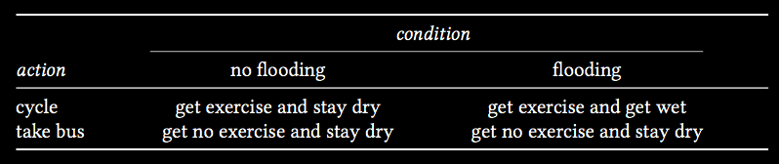
Actions, outcomes & conditions
Notes:
Proposal: we should take a constructive approach---creature construction.
And we should have a model of the attitudes, one that is clearly enough explained that we can tell whether it is capable of explaining a given individual’s behaviour in a particular case.
***use Dretske naturalism quote?
***start with mere goals and add in states that modulate, or go straight to decision theory?

Slide 31
Actions, outcomes & conditions
Notes:
Proposal: we should take a constructive approach---creature construction.
And we should have a model of the attitudes, one that is clearly enough explained that we can tell whether it is capable of explaining a given individual’s behaviour in a particular case.
***use Dretske naturalism quote?
***start with mere goals and add in states that modulate, or go straight to decision theory?

Slide 32
Actions, outcomes & conditions
Notes:
Proposal: we should take a constructive approach---creature construction.
And we should have a model of the attitudes, one that is clearly enough explained that we can tell whether it is capable of explaining a given individual’s behaviour in a particular case.
***use Dretske naturalism quote?
***start with mere goals and add in states that modulate, or go straight to decision theory?

Slide 33
Actions, outcomes & conditions
Notes:
Proposal: we should take a constructive approach---creature construction.
And we should have a model of the attitudes, one that is clearly enough explained that we can tell whether it is capable of explaining a given individual’s behaviour in a particular case.
***use Dretske naturalism quote?
***start with mere goals and add in states that modulate, or go straight to decision theory?

Slide 34
Actions, outcomes & conditions
Notes:
Proposal: we should take a constructive approach---creature construction.
And we should have a model of the attitudes, one that is clearly enough explained that we can tell whether it is capable of explaining a given individual’s behaviour in a particular case.
***use Dretske naturalism quote?
***start with mere goals and add in states that modulate, or go straight to decision theory?

Slide 35
Actions, outcomes & conditions
Notes:
Proposal: we should take a constructive approach---creature construction.
And we should have a model of the attitudes, one that is clearly enough explained that we can tell whether it is capable of explaining a given individual’s behaviour in a particular case.
***use Dretske naturalism quote?
***start with mere goals and add in states that modulate, or go straight to decision theory?

Slide 36
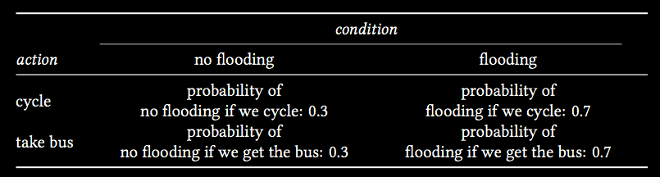
Actions, outcomes & conditions
Notes:
Proposal: we should take a constructive approach---creature construction.
And we should have a model of the attitudes, one that is clearly enough explained that we can tell whether it is capable of explaining a given individual’s behaviour in a particular case.
***use Dretske naturalism quote?
***start with mere goals and add in states that modulate, or go straight to decision theory?

Slide 37
Actions, outcomes & conditions
Notes:
Proposal: we should take a constructive approach---creature construction.
And we should have a model of the attitudes, one that is clearly enough explained that we can tell whether it is capable of explaining a given individual’s behaviour in a particular case.
***use Dretske naturalism quote?
***start with mere goals and add in states that modulate, or go straight to decision theory?

Slide 38
Actions, outcomes & conditions
Notes:
Proposal: we should take a constructive approach---creature construction.
And we should have a model of the attitudes, one that is clearly enough explained that we can tell whether it is capable of explaining a given individual’s behaviour in a particular case.
***use Dretske naturalism quote?
***start with mere goals and add in states that modulate, or go straight to decision theory?

Slide 39
Actions, outcomes & conditions
Notes:
Proposal: we should take a constructive approach---creature construction.
And we should have a model of the attitudes, one that is clearly enough explained that we can tell whether it is capable of explaining a given individual’s behaviour in a particular case.
***use Dretske naturalism quote?
***start with mere goals and add in states that modulate, or go straight to decision theory?

Slide 40
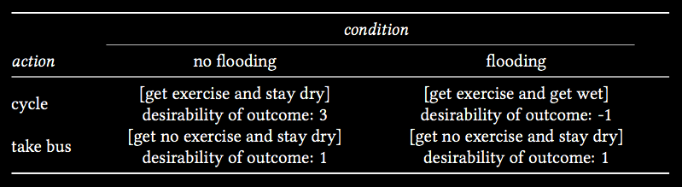
Actions, outcomes & conditions
Notes:
Proposal: we should take a constructive approach---creature construction.
And we should have a model of the attitudes, one that is clearly enough explained that we can tell whether it is capable of explaining a given individual’s behaviour in a particular case.
***use Dretske naturalism quote?
***start with mere goals and add in states that modulate, or go straight to decision theory?

Slide 41
Actions, outcomes & conditions
Notes:
Proposal: we should take a constructive approach---creature construction.
And we should have a model of the attitudes, one that is clearly enough explained that we can tell whether it is capable of explaining a given individual’s behaviour in a particular case.
***use Dretske naturalism quote?
***start with mere goals and add in states that modulate, or go straight to decision theory?

Slide 42
Actions, outcomes & conditions
Notes:
Proposal: we should take a constructive approach---creature construction.
And we should have a model of the attitudes, one that is clearly enough explained that we can tell whether it is capable of explaining a given individual’s behaviour in a particular case.
***use Dretske naturalism quote?
***start with mere goals and add in states that modulate, or go straight to decision theory?

Slide 43
‘Suppose that A and B are [outcomes] between which the agent is not indifferent, and that N is an ethically neutral condition [i.e. the agent is indifferent between N and not N].
Then N has probability 1/2 if and only if the agent is indifferent between the following two gambles.
B if N, A if not
A if N, B if not'
(Jeffrey 1983: 47)

Slide 44
‘modern philosophers ... have no theory of thought to speak of. I do think this is appalling; how can you seriously hope for a good account of belief if you have no account of belief fixation?’
(Fodor 1987: 147)

Slide 45


